Slide 1

DATA ANALYTICS PROJECT @

Slide 2
DATA ANALYSIS OF THE DEVELOPMENT OF A DIGITAL MARKETPLACE FOR RENEWABLE ENERGY PRODUCTS
Presented by Group 5

Slide 3
OVERVIEW
Market Research
Overview
Market Size & Growth
Market Trends & Customer Awareness
Competitor Analysis
User Preferences
Overview of Key Players
Primary Research , Trend Analysis, Insights & Recommendations
Team Members
Appreciations

Slide 4
MARKET RESEARCH
Market Overview:
Renewable energy is on an upward trajectory globally, driven by government mandates, corporate sustainability goals, and cost competitiveness.
In Nigeria, renewable energy expansion is part of a broader plan to close the significant power gap through distributed renewable energy resources and battery storage.
Nigeria faces a chronic energy shortage, with the national grid meeting only about 60% of energy needs for approximately 200 million people. Frequent blackouts and grid failures drive the demand for alternative energy sources.
This approach is essential to achieving a 20 GW renewable energy target by 2030, as outlined in the Nigerian government’s roadmap supported by institutions like the Rocky Mountain Institute and the Global Energy Alliance for People and Planet

Slide 5
Market Size and Growth:
The Nigerian renewable energy market was valued at around $2 billion in 2023, with an expected growth rate of 9-11% annually through 2030. Solar energy is the most significant driver, followed by wind and biomass. Due to the climate in Nigeria, they will benefit most from solar energy.
The Nigerian government has introduced policies like the National Renewable Energy and Energy Efficiency Policy (NREEEP) to support renewable energy adoption. The policy targets 23% renewable energy contribution to the national grid by 2030.
Market Trends and Customer Awareness
Rising Awareness: Increased environmental awareness, government initiatives, and incentives are boosting adoption, especially in urban and semi-urban regions.
Corporate and SME Focus: Businesses, particularly Small and Medium Enterprises (SMEs), are increasingly adopting renewable energy to avoid high fuel costs associated with diesel generators.
Consumer Sentiment: There is a shift toward renewable energy solutions driven by the desire for reliable power and a growing awareness of the economic and environmental benefits of solar and wind energy.

Slide 6
Competitor Analysis
In Nigeria, key players like SolarNigeria, Anergy, and Rubitec are actively addressing diverse segments of the market.
SolarNigeria targets off-grid rural households with solar mini-grids, leveraging international partnerships to keep costs accessible.
Anergy focuses on the C&I market with custom energy solutions and leasing options to accommodate business budgets. Meanwhile,
Rubitec specializes in rural electrification through community-based mini-grid projects, working with public and private partners to subsidize costs and ensure consistent power​

Slide 7
Features | SolarNigeria | Arnergy | Rubitec
Product range | Focus on solar products | Solar services | Rural solar products
Marketplace format | No, e-commerce only | No, service-oriented | No, project oriented
Delivery logistics | Limited options | Delivery included in service | Rural logistics focus
Payment options | Credit, debit cards | Subscription and installation plans | One-time payment
B2B and B2C flexibility | Primarily B2C | Primarily B2C | Primarily B2B
Installation & consulting services | Some partnerships | Included in service | Focus on government projects
Education & resources | Basic product information | Some educational content | Limited

Slide 8
User Preferences
User demand within the renewable energy sector reflects a strong preference for flexibility, affordability, and reliable power sources.
Reports indicate that both commercial and residential users prioritize financing options that lower upfront costs, such as leasing and installment plans, especially in regions with limited financial resources for energy infrastructure.
Additionally, corporate clients, particularly in the commercial and industrial sectors, favor tailored, scalable solar installations that help reduce operational costs.

Slide 9
Overview of key players in Nigeria's renewable energy marketplace—SolarNigeria, Anergy, and Rubitec—focusing on their market trends, offerings, pricing strategies, and user preferences:
1. SolarNigeria:
Trends and Market Role: SolarNigeria primarily targets Nigeria's power gap by supporting distributed energy resources (DERs) and off-grid solar solutions, especially for underserved rural areas. This aligns with the government’s roadmap to close the 20 GW energy deficit in Nigeria by 2030 through expanding DERs and battery storage options. SolarNigeria’s focus on mini-grids reflects the broader trend of using renewable energy to address Nigeria’s unreliable power grid.
Offerings and Pricing: SolarNigeria provides both solar mini-grids and solar home systems, aiming to keep costs accessible to reach rural and urban populations without grid access. Partnerships with international organizations and financing options make these solutions more affordable.
User Feedback: Users appreciate SolarNigeria’s emphasis on dependable service for off-grid areas and affordable pricing that matches local financial constraints, especially given the need for localized, modular solar solutions.

Slide 10
2. Anergy:
Trends and Market Role: Anergy works extensively in Nigeria’s commercial and industrial (C&I) sectors. With Nigeria's demand for large-scale clean energy solutions, Anergy focuses on providing reliable power through scalable solar installations for businesses. This approach addresses the economic impact of Nigeria’s energy shortfall, which costs the economy an estimated $29 billion annually.
Offerings and Pricing: Anergy’s product line includes solar photovoltaic systems and energy storage, with custom designs for commercial applications. Pricing is competitive, often involving leasing options to reduce upfront costs for businesses. Anergy’s integration of leasing aligns with C&I demand for flexible financing to ease capital expenses.
User Feedback: Feedback from commercial users highlights Anergy’s reliability and tailored solutions for high-energy-use clients, such as manufacturing and retail businesses. This B2B approach is popular among users who prioritize consistent, cost-saving energy sources.

Slide 11
3 Rubitec:
Trends and Market Role: Rubitec stands out for its work in rural electrification, deploying solar mini-grids in underserved areas. It focuses on integrating renewable sources like solar and small hydro-power systems for rural electrification, addressing the widespread lack of access to electricity.
Offerings and Pricing: Rubitec’s offerings span solar mini-grids, backup systems, and small-scale renewable energy projects, with pricing strategies that prioritize long-term partnerships with local communities and financing through partnerships. Rubitec’s approach often includes working with public and private stakeholders to subsidize costs.
User Feedback: Rural users valu Rubitec’s dedication to local electrification and its accessible energy solutions. Rubitec’s attention to installation quality and maintenance support is crucial in areas w consistent power is needed for daily operations and basic services.

Slide 12
Company | Trends and Market Role | Offerings and Pricing Strategy | User Feedback
SolarNigeria | Focuses on distributed energy resources (DERs) and off-grid solutions to meet Nigeria’s energy gap by 2030. | Provides solar mini-grids and home systems, with affordable pricing supported by international partnerships. | Valued for dependable off-grid power solutions, especially in rural areas needing localized, modular systems​ .
Anergy | Targets the Commercial & Industrial (C&I) sector, offering scalable solar installations to mitigate power costs. | Offers custom photovoltaic systems and storage, with flexible leasing to minimize upfront costs for businesses. | Positive reviews for reliability and cost-saving solutions, especially among energy-intensive businesses​ .
Rubitec | Prioritizes rural electrification with solar mini-grids and small hydro-power, focusing on underserved regions. | Provides mini-grids, backup systems, and renewable projects, with community partnerships to subsidize costs. | Appreciated in rural areas for high installation quality and maintenance, crucial for areas with limited power access​ .

Slide 13
Respondents Survey Question

Slide 14
Primary Research, Trend Analysis, Insights & Recommendations

Slide 15
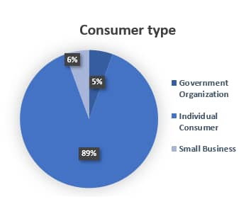
1.Consumer Demographics
Insight: The consumer base comprises primarily individual consumers (89%), followed by small businesses (6%) and government organizations (5%).
Recommendation: Tailor the marketplace to cater to individual consumers by focusing on user-friendly, self-service options and educational resources. For small businesses and government entities, consider offering bulk purchase options or customized solutions to support larger projects.

Slide 16
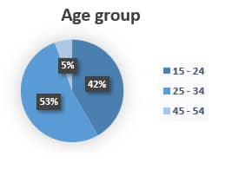
2. Age Group Analysis
Insight: A significant portion of respondents are young adults: 53% are aged 25–34 and 42% are aged 15–24. Only a small percentage (5%) are aged 45–54.
Recommendation: Given the youthful demographic, leverage social media and digital advertising to promote the platform, focusing on platforms popular with young adults. Educational content on renewable energy benefits could increase engagement among younger audiences.

Slide 17
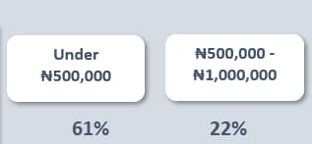
3. Budget Constraints
Insight: Most respondents (61%) indicated they can only spend under ₦500,000, while 22% fall into the ₦500,000–₦1,000,000 range, suggesting that affordability is a priority.
Recommendation: Offer a range of affordable product options and financing plans. Emphasize products like solar panel kits or entry-level inverters that align with these budget limits. Highlight any available government incentives or subsidies to further support affordability.

Slide 18
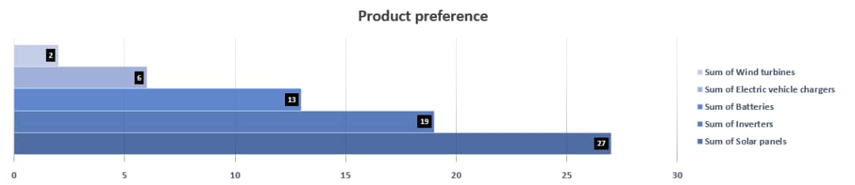
4. Product Preferences
Insight: The preferred products, based on multiple selections, include solar panels (27 selections), inverters (19), and batteries (13). Electric vehicle chargers (6) and wind turbines (1) received fewer mentions, indicating lower interest.
Recommendation: Focus initial marketplace offerings on solar panels, inverters, and batteries. Consider positioning electric vehicle chargers and wind turbines as niche products, targeting specific audiences with specialized marketing.

Slide 19
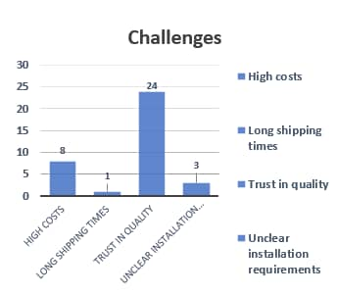
5 . Challenges and Pain Points
Insight: The biggest challenge for consumers is a lack of trust in product quality (24 responses), followed by concerns over high costs (8 responses) and, unclear installation requirement(3 responses) long shipping times (1 responses).
Recommendation: To build trust, emphasize quality assurance through detailed product descriptions, customer reviews, and certifications. Partner with reputable suppliers and highlight quality standards. Address cost concerns with transparent pricing and explore options to reduce shipping times where possible.

Slide 20
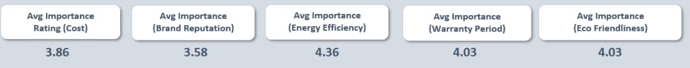
6. Importance Ratings of Purchase Factors
Insight: The most important factors in choosing renewable energy products are Energy Efficiency (4.36 average), followed by Eco-Friendliness and Warranty Period (both 4.03). Cost (3.86) and Brand Reputation (3.58) are rated lower.
Recommendation: Highlight energy-efficient products and provide detailed information on eco-friendliness to appeal to consumer priorities. Offer extended warranty options to increase consumer confidence. Consider introducing a “best value” badge to indicate products that balance efficiency and affordability.

Slide 21
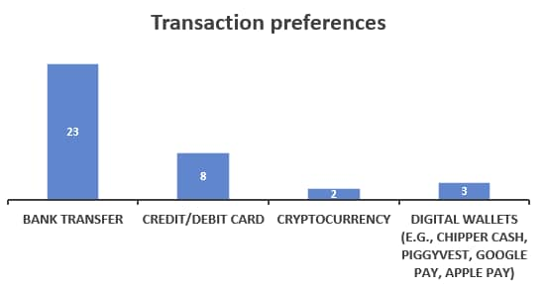
7. Transaction Preferences
Insight: The most preferred payment method is bank transfer (23 respondents), with smaller groups favoring credit cards (8), digital wallets (3), and cryptocurrency (2). No respondents chose PayPal.
Recommendation: Ensure that bank transfers are seamless and secure. Consider offering discounts for this payment method if feasible. Maintain a range of options, but prioritize the most popular ones, as these will likely enhance the user experience.

Slide 22
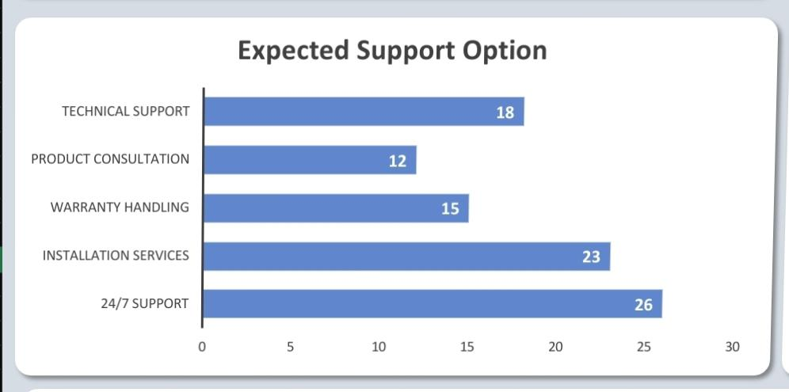
8. Expected Support Options Insight: In terms of customer support, 24/7 support (26 selections), installation services (23), and technical support (18) are the most desired options. Warranty handling (15) and product consultation (12) are also valued. Recommendation: Offer accessible 24/7 support, especially via chat or phone. Provide an option for professional installation services to enhance product usability and offer technical support resources like FAQs or video tutorials. Highlight warranty policies and include expert consultation services for users needing advice on product selection.

Slide 23
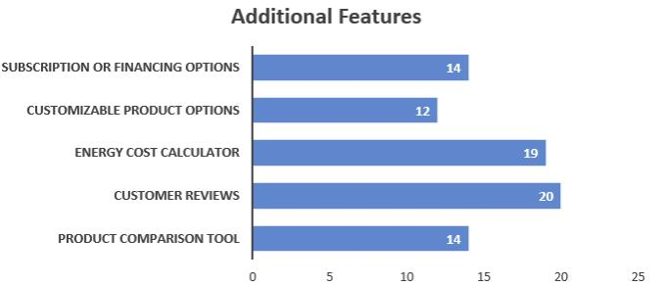
9. Additional Feature Preferences
Insights: Respondents showed high interest in customer reviews (20 selections) and energy cost calculators (19), with additional demand for subscription options and a product comparison tool (14 each). Customizable product options (12) were also requested, reflecting a desire for personalized and informative purchasing experiences.
Recommendations: Implement customer reviews to build trust, add an energy cost calculator to highlight potential savings, and provide subscription options for ongoing needs. Offer a product comparison tool to aid decision-making and customizable options for tailored solutions. These features will enhance user satisfaction and support informed choices.

Slide 24
Conclusion
The survey analysis reveals that the primary target market for the renewable energy market place consists of budget-conscious, young, individual consumers with a preference for solar energy solutions.
They value energy efficiency and eco-friendliness and are cautious about product quality and affordability.
By focusing on quality assurance, affordable product options, reliable customer support, and targeted digital marketing, the marketplace can effectively attract and serve this audience.
These recommendations align the market place’s offerings with consumer expectations, fostering a trustworthy platform that caters to the practical needs of the renewable energy community.

Slide 25
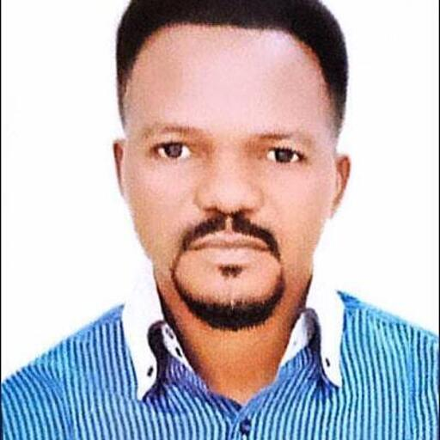



TEAM MEMBERS
Dr Samuel Israel
Product Manager/Data Analyst
Convenant Lenu
Data Analyst
Ifeka Odira Hillary
Data Analyst
Adebayo Deborah
Data Analyst

Slide 26
APPRECIATIONS @

